Slide 1
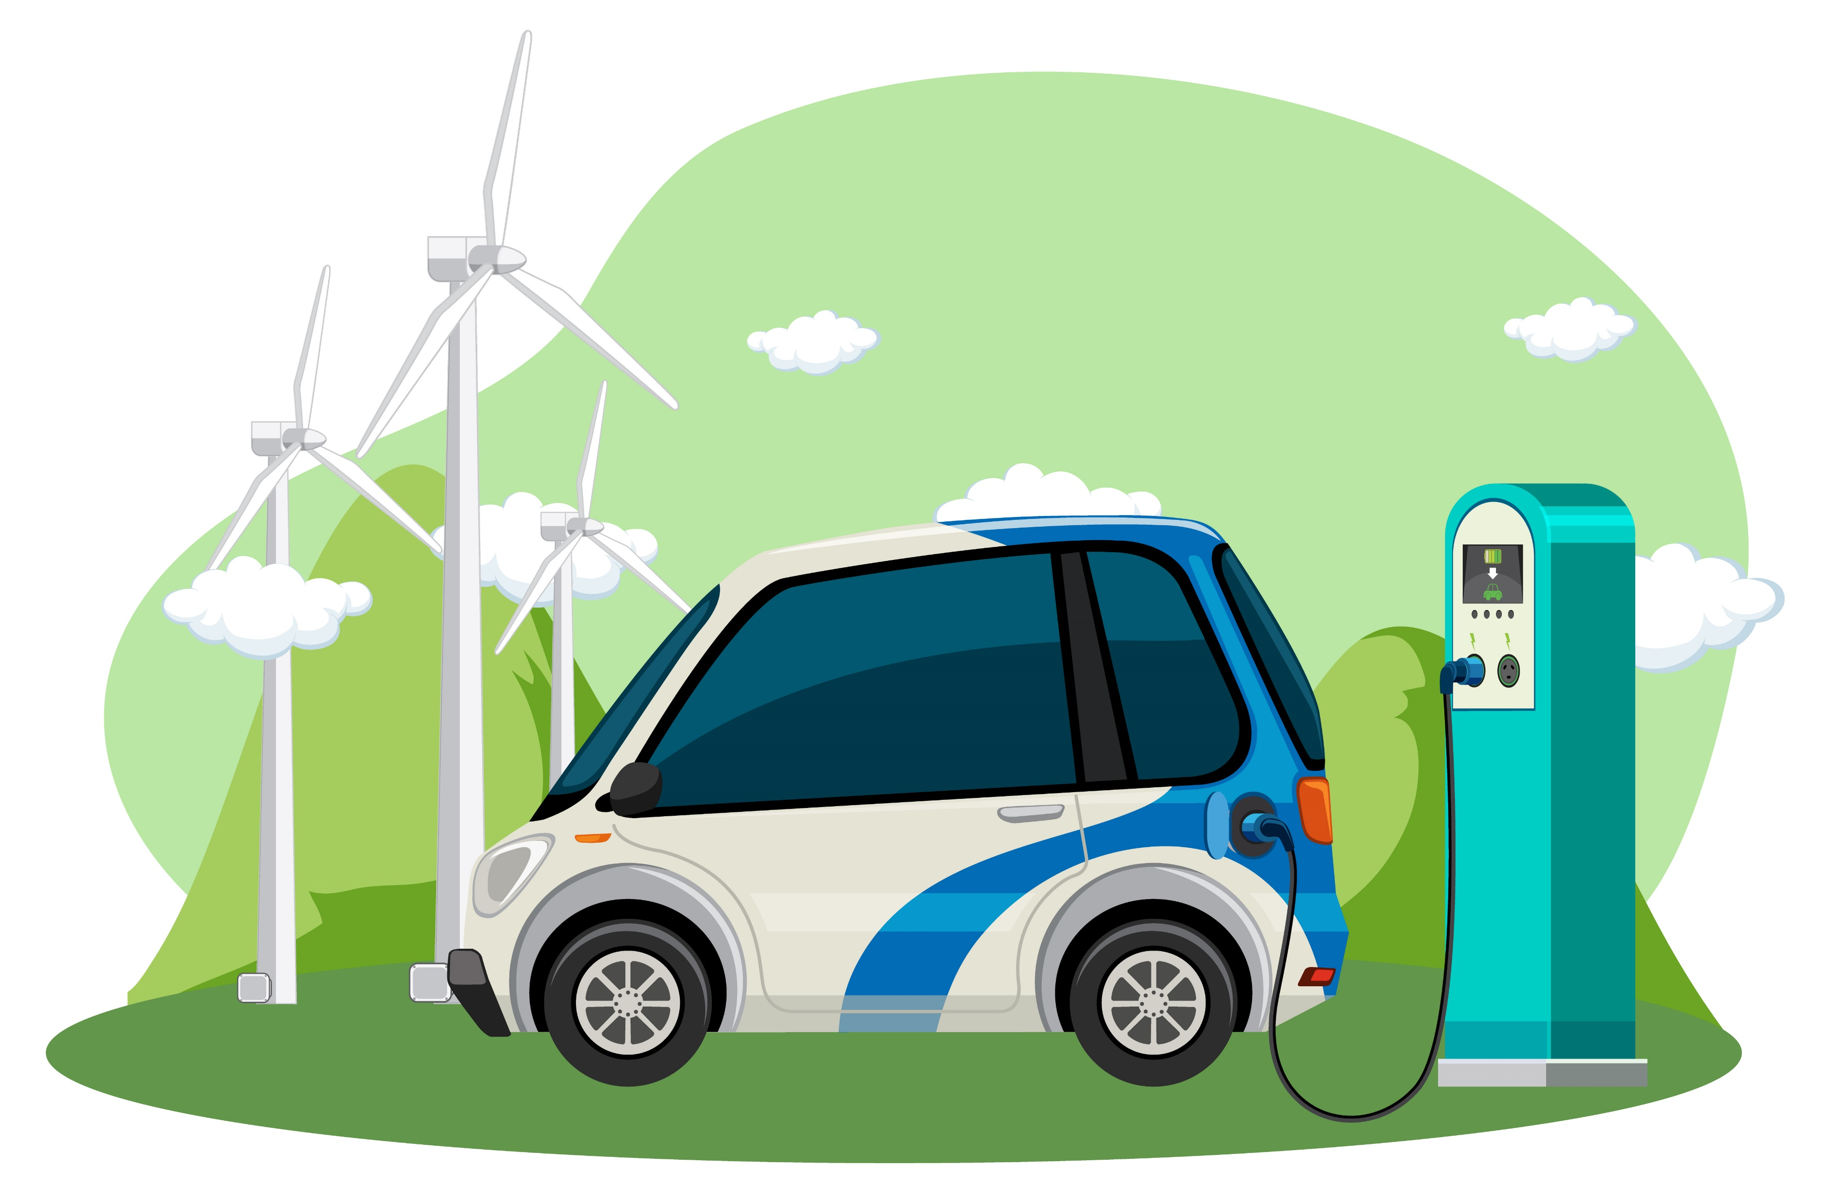

THE RISE OF ELECTRIC VEHICLES
Driving TOWARDS A SUSTAINABLE FUTURE

Slide 2
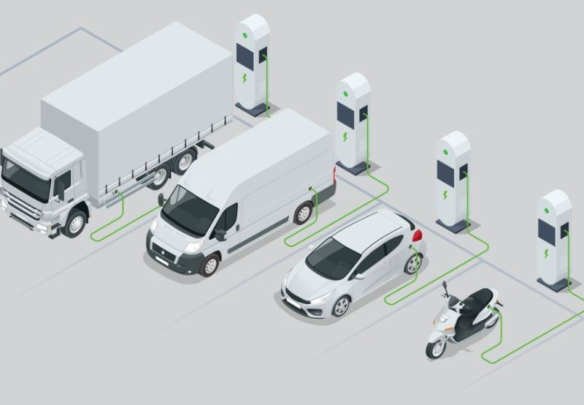
WHAT ARE ELECTRIC VEHICLES?
Electric vehicles (EVs) are a promising technology for achieving a sustainable transport sector in the future, due to their very low to zero carbon emissions, low noise, high efficiency, and flexibility in grid operation and integration.
These include battery electric vehicles, plug-in hybrid electric vehicles, hybrid electric vehicles and fuel cell electric vehicles.
Growing demand due to environmental awareness and government policies
India EV Policy

Slide 3
EV MARKET GROWTH OVER THE YEARS
The global EV market is experiencing exponential growth, driven by incentives, tech innovations, and rising fuel prices.

Slide 4

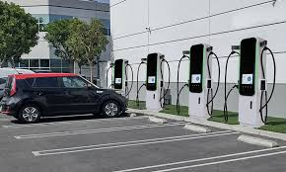
WHY EV’s? PROS AND CONS
Advantages
Electric cars are energy efficient
Electric cars reduce emissions
Electric cars require lower maintenance
Challenges
Electric cars cannot travel as far
“Fueling” takes longer
Electric cars are sometimes more expensive

Slide 5
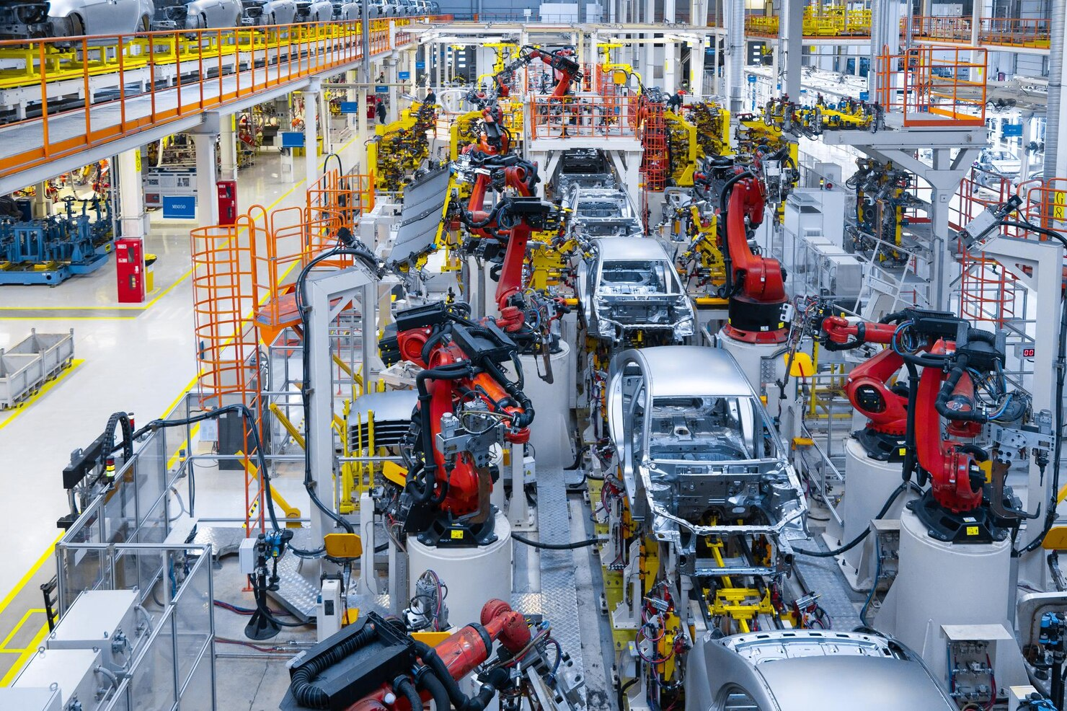
THE ROAD AHEAD
Affordable EV models for mass adoption – Manufacturers are introducing budget-friendly electric cars, making them accessible to middle-class buyers and increasing global adoption rates.
Faster and more accessible charging infrastructure – Expansion of ultra-fast charging networks and more public charging stations will reduce range anxiety and make EVs practical for long-distance travel.
Longer battery life and improved safety – Advancements in battery technology, such as solid-state batteries, will increase driving range, reduce charging time, and enhance safety in extreme conditions.
Integration of autonomous driving technology – Future EVs will combine electric propulsion with self-driving features, enabling safer, more efficient, and convenient transportation.

